Slide 1
Case Study – Lawn King, Inc
Satya Devi Julakanti (667258378)
Shivam saini (663237584)
Harshanath PS (674850058)
Rakesh Marothu (653927889)

Slide 2
Introduction
Lawn King is a medium-sized producer of lawn mower equipment
Last year, sales were $14.5 million and pretax profits were $2 million
Our objective here is to develop a aggregate plan my month for FY 2011 making use of the historic data of FY 2010
Lawn King manufacture 4 types of lawn movers - an 18-inch push mower, a 20-inch push mower, a 20-inch self-propelled mower, and a 22-inch deluxe self-propelled mower.

Slide 3
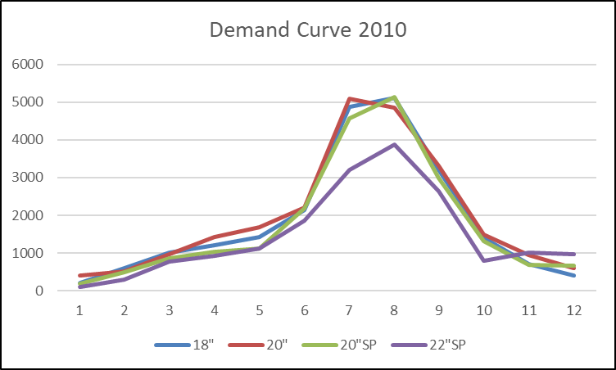
Demand – FY 2010
The above graph, indicates a seasonality in sales of lawn movers in the months March – May 2010, summer months.

Slide 4
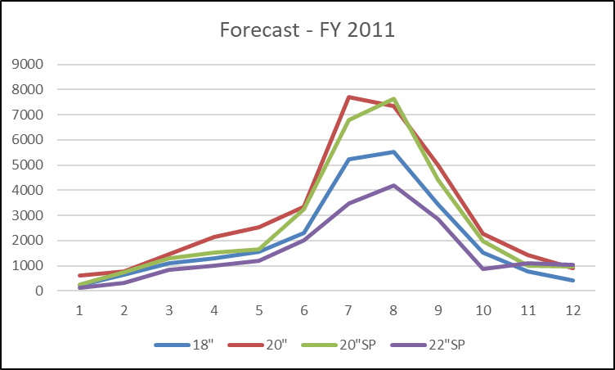
Forecast – FY 2011
Above is the forecasted demand curve for the year 2011.
We have used the available forecast numbers for different types of mowers and spread them across the months in the ratio of previous years demand, so that it accounts for seasonality in summer months

Slide 5
Before moving forward with Aggregate Planning, lets first look into the assumptions, cost parameters and constraints for the model

Slide 6
Assumptions and Key points from case study
No of days per month – 20
No of work hours per day – 8
Total demand for the year 2010 is 84600 but the total production is 84450 which implies that they could not meet the demand for they year 2010.
We will consider 84450 has the total units produce for the year 2010
Inventory holding cost is 30% of carrying a cost for the year ie. 30% of Cost of good sold
$42000 per year was spent on training 50 employees (50% of 100)
Workforce = assembly line + machine shop i.e 60+25 = 85

Slide 7
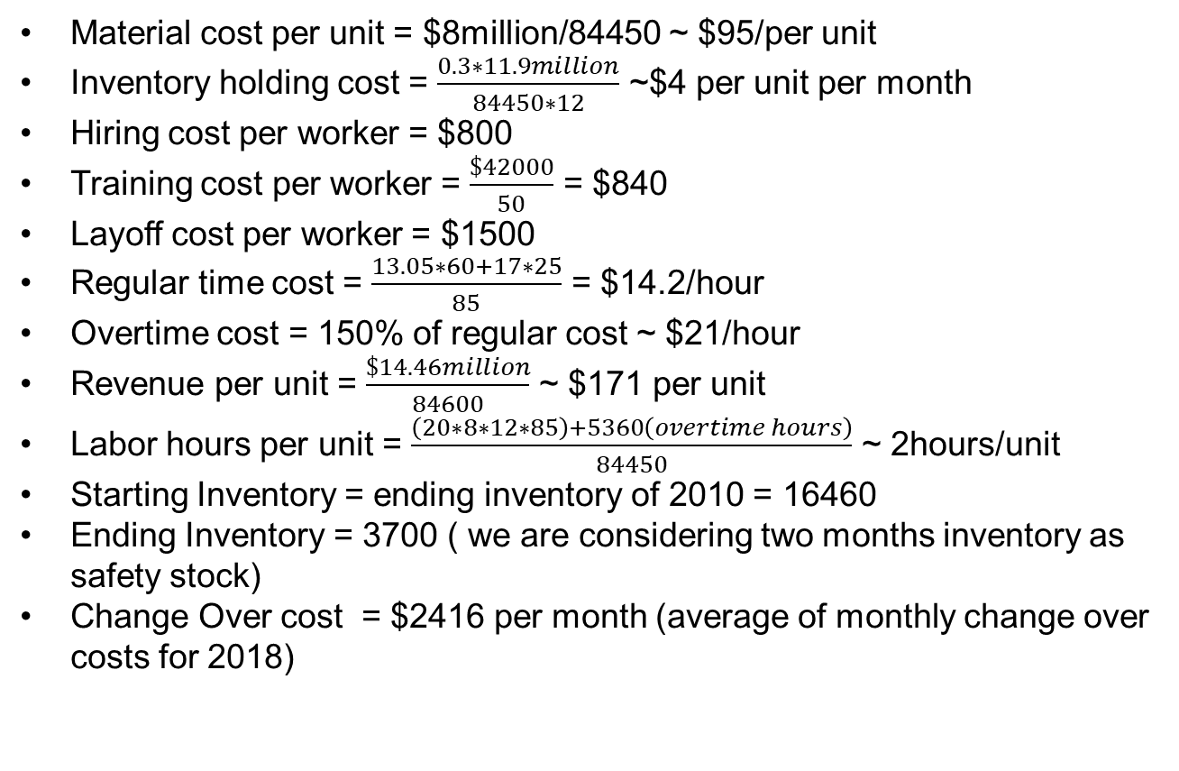
Cost Parameters
Material cost per unit = $8million/84450 ~ $95/per unit
Inventory holding cost = $\frac{0.3∗11.9million}{84450∗12}$ ~$4 per unit per month
Hiring cost per worker = $800
Training cost per worker = $\frac{\$42000}{50}$ = $840
Layoff cost per worker = $1500
Regular time cost = $\frac{13.05∗60+17∗25}{85}$ = $14.2/hour
Overtime cost = 150% of regular cost ~ $21/hour
Revenue per unit = $\frac{\$14.46million}{84600}$ ~ $171 per unit
Labor hours per unit = $\frac{\left(20∗8∗12∗85\right)+5360\left(overtime hours\right)}{84450}$ ~ 2hours/unit
Starting Inventory = ending inventory of 2010 = 16460
Ending Inventory = 3700 ( we are considering two months inventory as safety stock)
Change Over cost = $2416 per month (average of monthly change over costs for 2018)

Slide 8
Level Strategy
In level strategy, a stable machine capacity and workforce are maintained with a constant output rate.
In order to fulfil this demand we need to use full work force of 85 people working with maximum overtime hours of 60 hours
We consider production Pt , Inventory It, Overtime Ot ,workers Wt as constraints.
Initially, opening Inventory is 16,460 units which is carried from previous year inventory and the Ending inventory is 3699 units which acts as a safety stock

Slide 9
Maximum Overtime per month – 60hrs/month
The average demand per month = $\frac{110000}{12}$=9167
The average demand per month = 110000/12=9167
No of labour hours needed to achieve this 9167*2(2hrs/unit)= 18334 hrs
No of hours per person = $\frac{18334}{85}$ ~ 216hrs/month
No of hours per person = 18334/85 ~ 216hrs/month
A person can work for 20*8 = 160 hrs/month
Overtime that a person should do to meet the demand = 216-160 ~ 55
Therefore we have taken the maximum overtime constrain to be 60hrs/month for level strategy

Slide 10
Constraints
Time period for this plan is 12 months
Initial Condition:
W₀ = 85, I₀ = 16460, I₁₂ = 3699
Workforce Constraint:
W_{t} - W_{t-1} = 0
Inventory Constraint:
I_{t-1} - I_{t} + P_{t} - D_{t} = 0
Overtime Constraint:
O_{t} - Maximum overtime hours* W_{t} <= 0
Capacity Constraint:
Max production in month + overtime production per month - P_{t} >= 0

Slide 11
Cost Function
The main objective of the aggregate planning is minimize cost function
Cost Constraint:
160*14 ∑ W_{t} + 4 ∑ I_{t} + 21 ∑ O_{t} + 95 ∑ P_{t} + change_over_cost → minimized

Slide 13
Chase Strategy
Production is synchronized with the demand rate by varying machine capacity or hiring and layoff employees.
Work force is varying in chase strategy and we have additional cost parameters such as hiring cost H_{t} and layoff cost F_{t}
Initially, opening Inventory is 16,460 units which is carried from previous year’s inventory and the ending inventory is 3699 units which acts as a safety stock

Slide 14
Constraints
Time period for this plan is 12 months
Initial Condition:
W₀ = 85, I₀ = 16460, I₁₂ = 3699
Workforce Constraint:
W_{t-1} - W_{t} + H_{t} - F_{t}= 0
(W_{t-1} + H_{t} - F_{t} )*80 + overtime production per month - P_{t} = 0
W_{t} <= 85, as the plant can accommodate only a maximum of 85 people
Inventory Constraint:
I_{t-1} - I_{t} + P_{t} - D_{t} = 0
Overtime Constraint:
O_{t} - Maximum overtime hours* W_{t} <= 0
Capacity Constraint:
Max production in month + overtime production per month - P_{t} >= 0

Slide 15
Cost Function
The main objective of the aggregate planning is minimize cost function
Cost Constraint:
160*14 ∑ W_{t} + 4 ∑ I_{t} + 21 ∑ O_{t} + 95 ∑ P_{t} + 1640 ∑ H_{t} + 1500 ∑ F_{t} + change_over_cost → minimized.

Slide 17
Level Strategy – Two shift
In level strategy, a stable machine capacity and workforce are maintained with a constant output rate.
We are considering two shifts, with total work force of 115 people.
The average demand of each month is around 9167 units and we require 115 workforce in order to fulfil the demand.
The entire workforce is divided into two shifts, with first shift 85 and second shift 30.
We consider production Pt , Inventory It, Overtime Ot ,workers Wt as constraints.
Initially, opening Inventory is 16,460 units which is carried from previous year inventory and the Ending inventory is 3699 units which acts as a safety stock
As we are utilising two shifts, we don’t need to use much of over time.

Slide 18
Constraints
Time period for this plan is 12 months
Initial Condition:
W₀ = 85, I₀ = 16460, I₁₂ = 3699
Workforce Constraint:
W_{t} - W_{t-1} = 0
Inventory Constraint:
I_{t-1} - I_{t} + P_{t} - D_{t} = 0
Overtime Constraint:
O_{t} - Maximum overtime hours* W_{t} <= 0
Capacity Constraint:
Max production in month + overtime production per month - P_{t} >= 0

Slide 19
Cost Function
The main objective of the aggregate planning is minimize cost function
Cost Constraint:
160*14 ∑ W_{t} + 4 ∑ I_{t} + 21 ∑ O_{t} + 95 ∑ P_{t} + change_over_cost + 1640H_{t} → minimized

Slide 21
Chase Strategy
Production is synchronized with the demand rate by varying machine capacity or hiring and layoff employees.
Work force is varying in chase strategy and we have additional cost parameters such as hiring cost H_{t} and layoff cost F_{t}
Initially, opening Inventory is 16,460 units which is carried from previous year’s inventory and the ending inventory is 3699 units which acts as a safety stock
If there is a limit of 85 workers per shift , then chase strategy is not feasible as the numbers of workers can be more than 85 for certain months when demand is high.
Maximum of 170 workers can be hired for two shifts and based on demand hiring and layoff take's place

Slide 22
Constraints
Time period for this plan is 12 months
Initial Condition:
W₀ = 85, I₀ = 16460, I₁₂ = 3699
Workforce Constraint:
W_{t-1} - W_{t} + H_{t} - F_{t}= 0
(W_{t-1} + H_{t} - F_{t} )*80 + overtime production per month - P_{t} = 0
W_{t} <= 85, as the plant can accommodate only a maximum of 85 people
Inventory Constraint:
I_{t-1} - I_{t} + P_{t} - D_{t} = 0
Overtime Constraint:
O_{t} - Maximum overtime hours* W_{t} <= 0
Capacity Constraint:
Max production in month + overtime production per month - P_{t} >= 0

Slide 23
Cost Function
The main objective of the aggregate planning is minimize cost function
Cost Constraint:
160*14 ∑ W_{t} + 4 ∑ I_{t} + 21 ∑ O_{t} + 95 ∑ P_{t} + 1640 ∑ H_{t} + 1500 ∑ F_{t} + change_over_cost → minimized.

Slide 25
Conclusion:
In the single shift strategies the costs are minimized in chase than level strategy. As the initial inventory at start of the fiscal year is large, chase strategy helps to minimize inventory holdings. In order to meet the demand in chase strategy the most of workforce is utilized which is resulting in less hiring and layoffs costs.
If the company plans to introduce new shift then they can attain more profits as the overtime costs are reduced. Chase strategy with double shift is yielding more profit because of less inventory holding costs where as level strategy has constant workforce which results in high regular time costs irrespective of production rate.
Double shift is more profitable and puts less pressure on workforce as overtime is eliminated. Also with inclusion of double shift the company is able to expand its production capacity.

